Slide 1
Neural Network Model
A neural network is a computational model inspired by the way biological neural networks in the human brain work. It's a key component of machine learning and artificial intelligence
The output of the Neural Network training process reveals the model's performance across 50 epochs. The loss, representing the Mean Squared Error (MSE), is displayed for both the training and validation datasets. In the initial epochs, the training and validation losses are extremely high, reaching into the tens of trillions. This suggests that the model struggles to capture the underlying patterns in the data effectively.

Slide 2
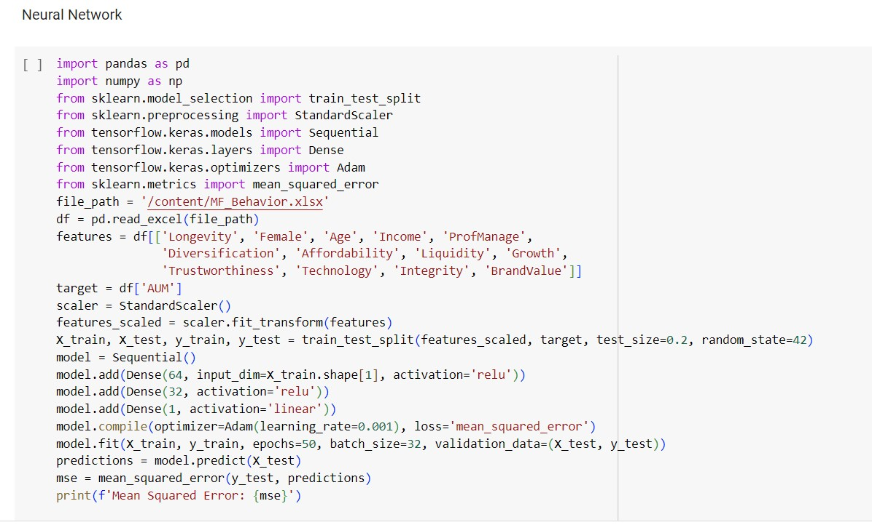
Code

Slide 3
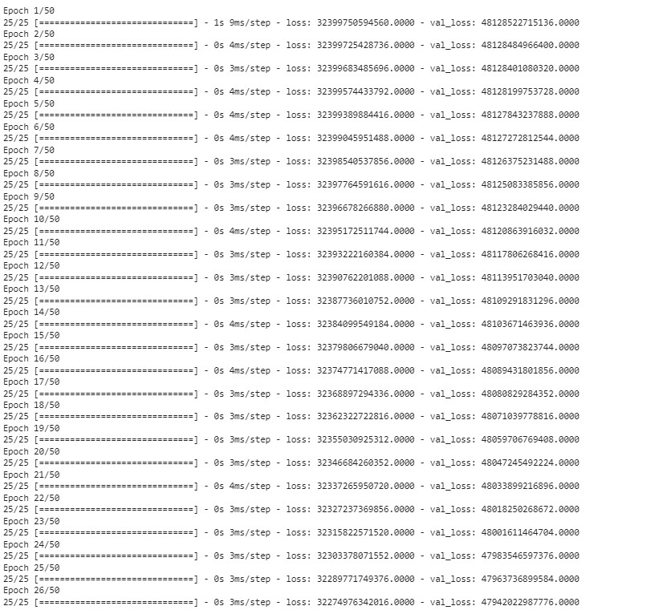

Output

Slide 4
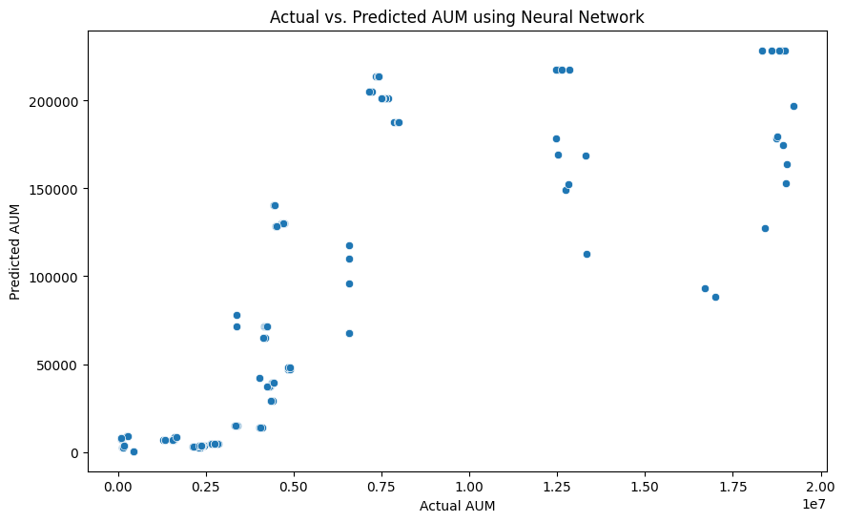
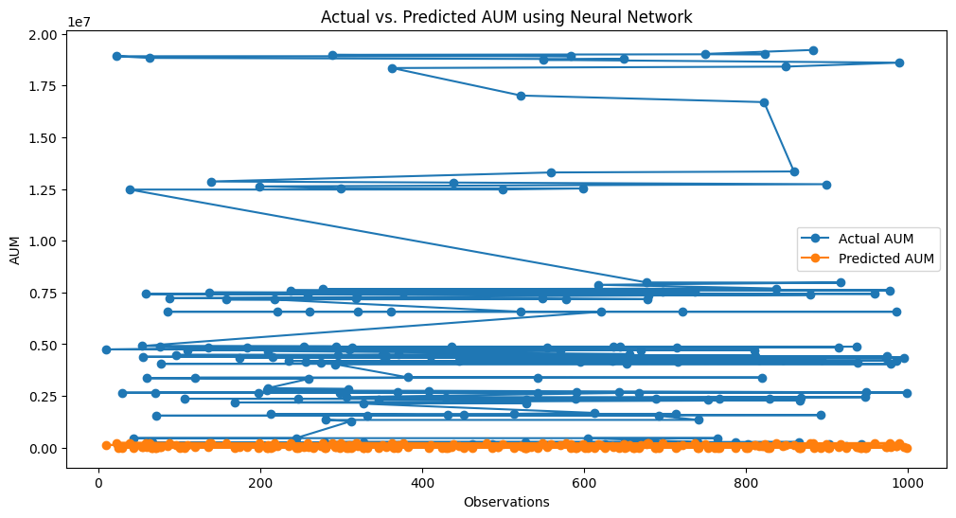

Slide 5
Decision Tree model
The Decision Tree model, characterized by its intricate branching structure, resulted in a Mean Squared Error (MSE) of approximately 11.42 billion. This suggests a complex and detailed capturing of the relationships within the dataset, potentially to the point of overfitting. In the context of the broader insights gained from the initial analysis, the Decision Tree's complexity aligns with the identification of key variables influencing market trends and the quantification of investor sentiment's impact on market dynamics. However, the relatively high MSE signals a need for refinement to enhance the model's accuracy. This parallels the broader exploration goals, where refining predictive models is identified as a key area for improvement.

Slide 6
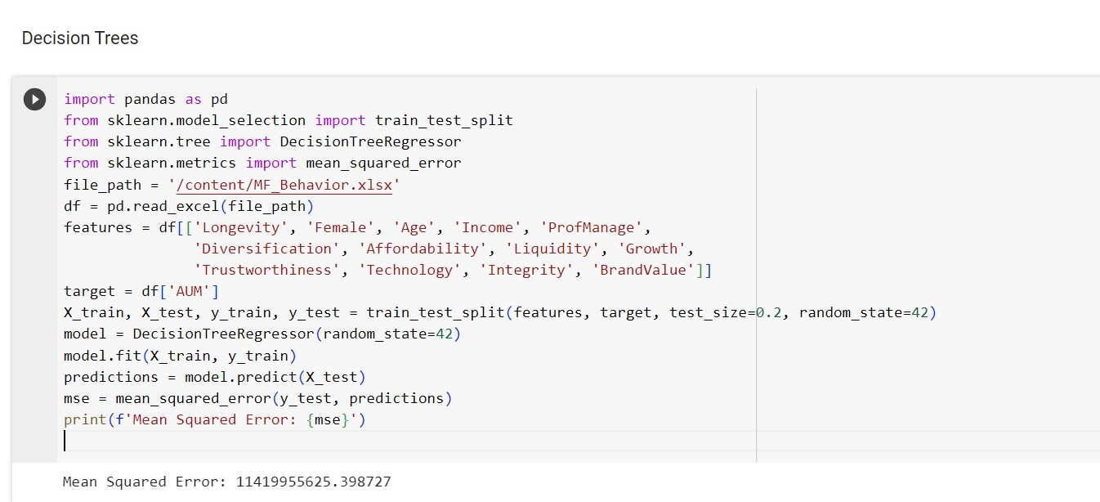
Code

Slide 7
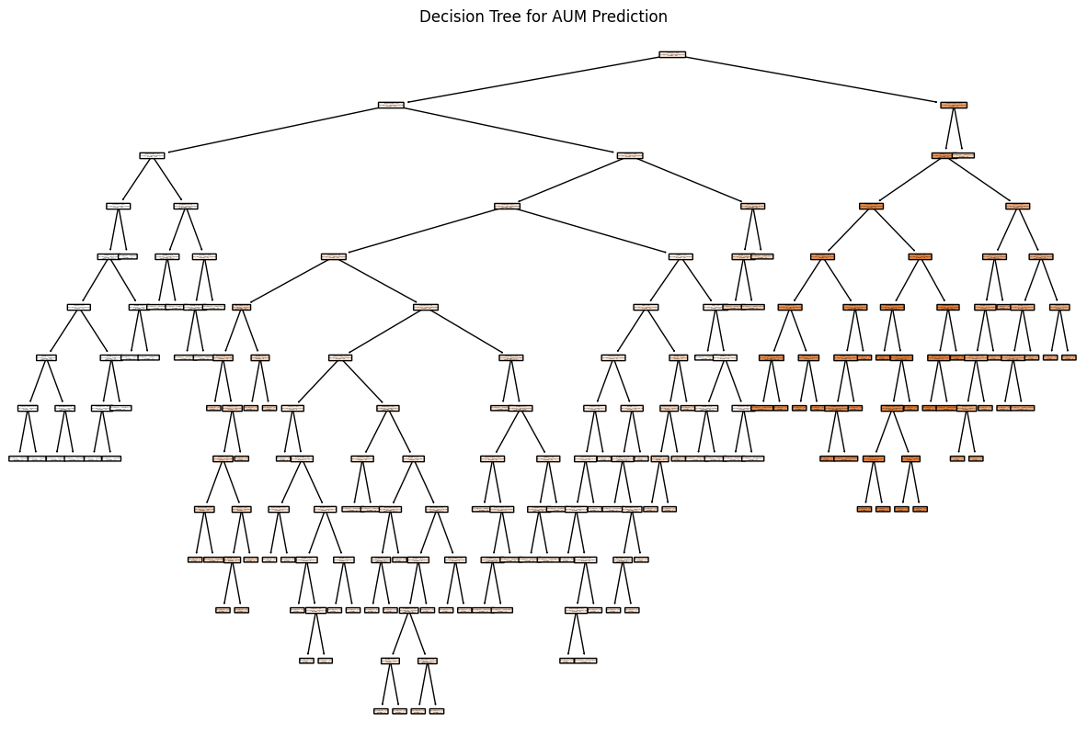
Decision Tree for AUM Prediction

Slide 8
Sentiment Analysis
Sentiment analysis, also known as opinion mining. It involves determining the emotional tone or subjective information expressed
An integral aspect of our research involves the nuanced task of decoding the emotional undercurrents within financial news
The goal is to unveil the emotional nuances embedded in news articles, providing valuable insights into how these sentiments influence investor behaviour and, reciprocally, how market trends impact sentiment.
sentiment analysis adds a layer of emotional intelligence to our research. By decoding the subtle emotional cues within financial news, they enhance our ability to comprehend the intricate relationship between sentiment and market dynamics, ultimately empowering investors with a deeper understanding of the forces shaping the financial landscape.

